Slide 1

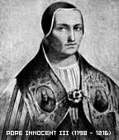
Pope Innocent III
By : Ashish

Slide 2
Pope Innocent III
Born -1160
Died – 16th July 1216
Birth name – Lotario dei conti de segni
Educated in Rome, Paris and Bologna.

Slide 3
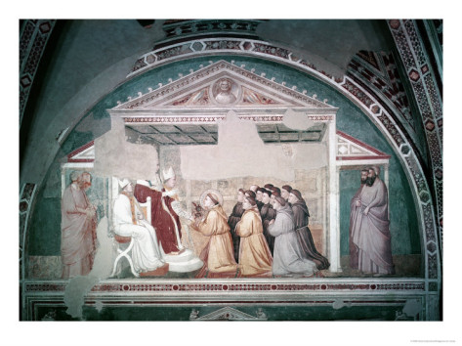
Became pope on 8th January 1198
In 1190, He made a cardinal deacon by pope clement III.

Slide 4
Powerful and Influential
Exerted a wide influence over the Christians regimes.

Slide 5
What did it mean to be the Pope in the thirteenth century?
Why was Innocent such a great pope?

Slide 6


