Slide 1
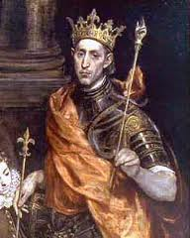
St. Louis IX king of France
25 April 1214 – 25 August 1270

Slide 2
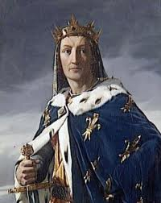
Family
Father died in 1226
His mother ruled instead of him,
Brother become count of Anjou,
Louis marred Margaret of Provence

Slide 3
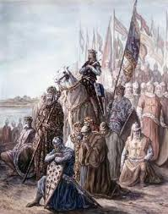
The Seventh Crusade
Announcement of crusade in 1224
Sailing to Egypt
Attack on Cairo
Louis taken as a prisoner
Return home

Slide 4
The Eight Crusade
Started by going to Tunis
Setting a camp
dysentery in the camp
Death of Louis

