Slide 1
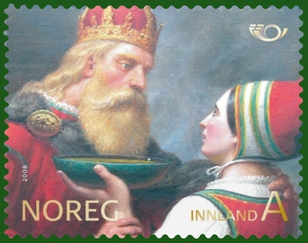
Harald Fairhair

Slide 2
Harald Fairhair or Harald Finehair was the son of Halfdan the Black and was the first king of Norway.

Slide 3
In Heimskringla it is claimed that Harald succeeded, on the death of his father Halfdan the Black Gudrödarson, to the sovereignty of several small, and somewhat scattered kingdoms in Vestfold, which had come into his father's hands through conquest and inheritance. His protector-regent was his mother's brother Guthorm.

Slide 4
The unification of Norway is, according to a tale narrated in Heimskringla, something of a love story. The tale begins with a marriage proposal that resulted in rejection and scorn from Gyda, the daughter of Eirik, king of Hordaland. She said she refused to marry Harald "before he was king over all of Norway". Harald was therefore induced to take a vow not to cut nor comb his hair until he was sole king of Norway, and that ten years later, he was justified in trimming it; whereupon he exchanged the epithet "Shockhead" or "Tanglehair" for the one by which he is usually known. Most scholars today regard this story as a literary tale inspired by the Romance stories that were popular at the courts by the time Heimskringla was written.

Slide 5
In 866, Harald made the first of a series of conquests over the many petty kingdoms which would compose all of Norway, including Värmland in Sweden, which had sworn allegiance to the Swedish king Erik Eymundsson. In 872, after a great victory at Hafrsfjord near Stavanger, Harald found himself king over the whole country. His realm was, however, threatened by dangers from without, as large numbers of his opponents had taken refuge, not only in Iceland, then recently discovered; but also in the Orkney Islands, Shetland Islands, Hebrides Islands, Faroe Islands and the northern European mainland. However, his opponents' leaving was not entirely voluntary. Many Norwegian chieftains who were wealthy and respected posed a threat to Harald; therefore, they were subjected to much harassment from Harald, prompting them to vacate the land. At last, Harald was forced to make an expedition to the West, to clear the islands and the Scottish mainland of some Vikings who tried to hide there.

Slide 6
The latter part of Harald's reign was disturbed by the strife of his many sons. The number of sons he left varies in the different saga accounts, from 11 to 20. Twelve of his sons are named as kings, two of them over the whole country. He gave them all the royal title and assigned lands to them, which they were to govern as his representatives; but this arrangement did not put an end to the discord, which continued into the next reign. When he grew old, Harald handed over the supreme power to his favourite son Eirik Bloodaxe, whom he intended to be his successor. Eirik I ruled side-by-side with his father when Harald was 80 years old. Harald died three years later due to age in approximately 933.

Slide 7
Harald Harfager was commonly stated to have been buried under a mound at Haugar by the Strait of Karmsund near the church in Haugesund, an area that later would be named the town and municipal Haugesund. The area near Karmsund was the traditional burial site for several early Norwegian rulers. The national monument of Haraldshaugen was raised in 1872, to commemorate the Battle of Hafrsfjord in 872.

Slide 8
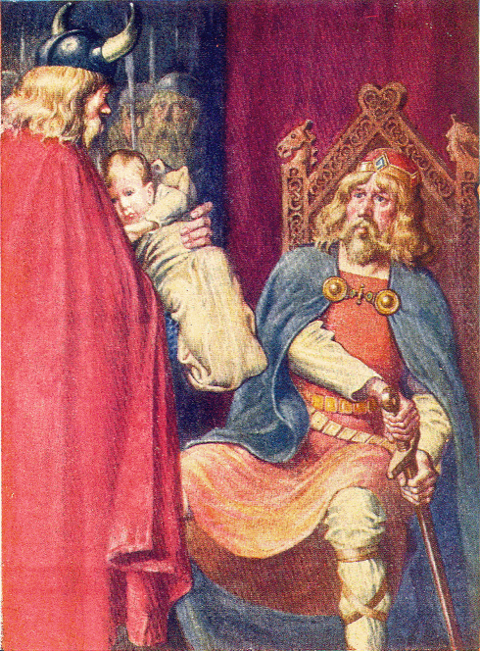
Thanks for listening~!

