Slide 1
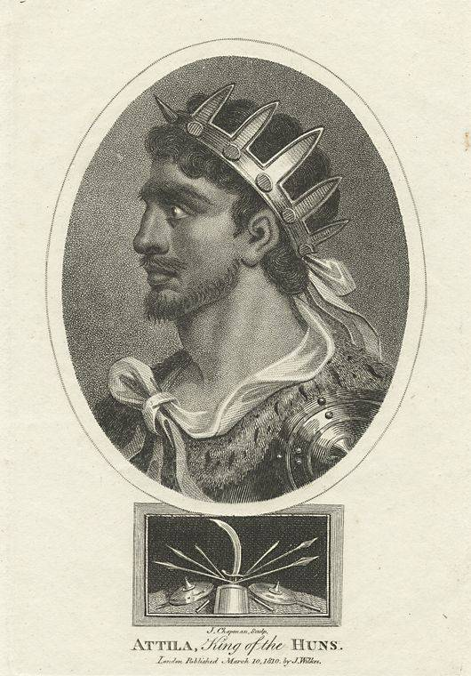
Attila The Hun
434-453

Slide 2
The Ruler Of Huns
Attila the Hun was king and general of the Hun empire from A.D. 434 to 453.
The huns - The Huns were a group of nomadic (roaming) herdsmen, warlike people from the North Central Asia north of China (Mongolia).

Slide 3
Hunnic Empire
Stretched from the Ural river to the Rhine river and from the Danube to the Baltic Sea.

Slide 4
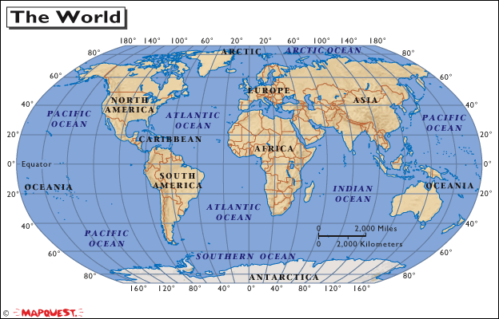

Slide 5
Peace Treaty Between Rome and Attila the Hun
Cheated to East Roman Emperor Theodosius II.

Slide 6
The Death

Slide 7
Why exactly was Attila the Hun so terrifying?
Torturer
Trouble maker

Slide 8
Thank you

