Slide 1
DHMO: the universal killer
ToK 25xi13
richard.major@bisb.hu

Slide 2
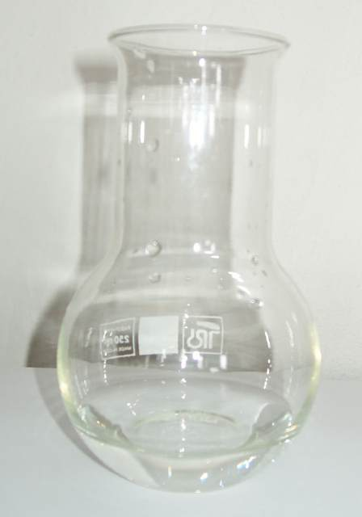
WHAT IS DHMO?
Dihydrogen monoxide (DHMO)
is a colourless, odourless chemical compound, also referred to by some as dihydrogen oxide, hydrogen hydroxide, hydronium hydroxide, or simply hydroxyl acid.
It is a tremendously dangerous chemical.
Its basis is the highly reactive hydroxyl radical, a species shown to mutate DNA, denature proteins, disrupt cell membranes, and chemically alter critical neuro-transmitters.
The atomic components of DHMO are found in a number of caustic, explosive and poisonous compounds such as sulphuric acid, nitroglycerine and ethyl alcohol.

Slide 3
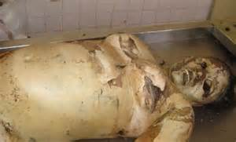
DHMO AND YOUR
HEALTH
Death can result from inhalation of DHMO even in small quantities. The victim above shows the bloating and discoloration typical of massive DHMO exposure, which is the sole cause of death for 140,000 people globally each year.
■ Prolonged exposure to solid DHMO causes severe tissue damage.
Gaseous DHMO can cause severe burns.
■ DHMO exposure leads to corrosion and oxidation of many metals, and is a frequent cause of bridge collapses
■ DHMO contamination of electrical systems often causes short-circuits and sometimes electrocution.
■ DHMO exposure decreases effectiveness of automobile brakes, leading to many deaths
■ DHMO is found in biopsies of pre-cancerous tumors and lesions.
■ DHMO was given to vicious dogs within hours of recent deadly attacks.

Slide 4
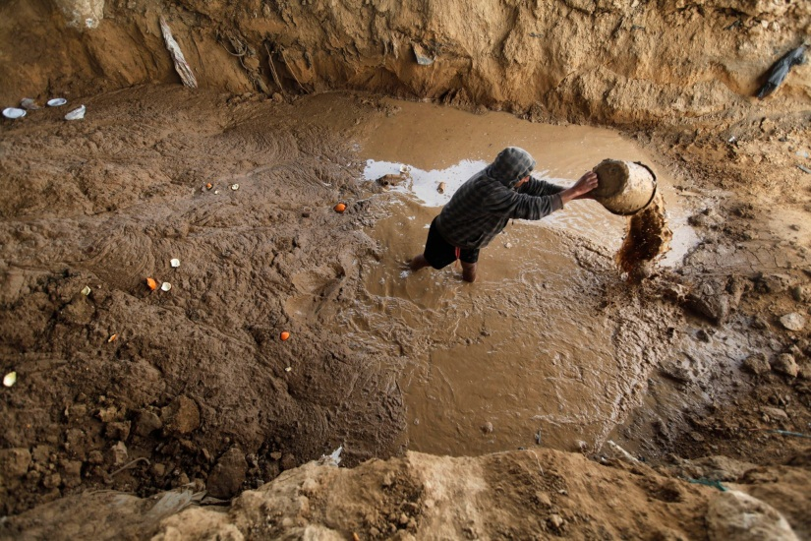
ENVIRONMENTAL ISSUES
Research has shown that significant levels of DHMO were found in the Indian Ocean tsunami in 2004 which killed 230,000 in Indonesia, Thailand, Malaysia and elsewhere, making it the deadliest tsunami in recorded history.
Moreover, DHMO
☞ contributes to global warming and the Greenhouse Effect, and is one of the so-called greenhouse gasses.
is an “enabling component” of acid rain -- in the absence of sufficient quantities of DHMO,
acid rain is not a problem.
☞ is a causative agent in most instances of soil erosion
has been measured at high levels in virtually every creek, stream, pond, river, lake
and reservoir in Europe
has been verified at measurable levels in ice samples
taken from both the Arctic and Antarctic ice caps.
☞ contaminates virtually all sewage (including this)

Slide 5
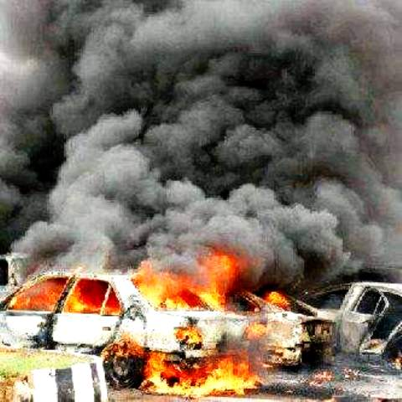
DHMO AND VIOLENCE
DHMO, an industrial solvent and coolant, is used
■ in nuclear power plants,
■ in biological and chemical weapons manufacture,
■ in the development of genetically engineering crops
and animals,
■ as a major ingredient in many home-made bombs,
including the one shown here (in Sri Lanka).
Other controversial uses include
■ ingestion by elite athletes to improve performance,
■ the production of Styrofoam.
DHMO is a factor in many acts of extreme acts of violence, including school shootings.
Many of the perpetrators are known to have had high amounts of DHMO in their systems at the time of the attacks. Nonetheless, DHMO is often available to students of all ages within the apparently safe confines of school buildings. School administrators are often unable say for certain how much of the substance is in use within their hallways.

Slide 6
THE POLITICS OF DHMO
Since DHMO or hydroxyl acid is a constituent of many known toxic substances, diseases and disease-causing agents, environmental hazards. and can be lethal to humans in quantities as small as a thimbleful, why is its use not banned or even seriously regulated?
PEOPLE UNDERSTAND THE TRUTH!
A recent study conducted by researchers Patrick K. McCluskey and Matthew Kulick found
that nearly 90% of the citizens participating in their study were willing to sign a petition to support an outright ban on the use of DHMO.
YET GOVERNMENTS REFUSE TO ACT
The world’s military establishment s are thoroughly reliant on DHMO use.
Many countries also seem compromised by massive economic reliance on and investment in DHMO, which is a component (very rarely explicitly acknowledged) in a wide range of economic activities.
The European Union, for instance, refuses to classify dihydrogen monoxide as a toxic or carcinogenic substance, as it does with better known chemicals such as hydrochloric acid and benzene.

Slide 7
So what should we do?
Ask yourself:

Slide 8
are you prepared to sign a petition calling for an outright ban on the exploitation of DHMO?

Slide 9
Or at least for immediate action against its promiscuous use?

Slide 10

Get involved!
This is the website for those concerned with arousing people to the threat of hydroxyl acid:
www.DHMO.org

